Slide 1





Tell a story with cartoon people
PowerPoint illustration kit
v

Slide 2
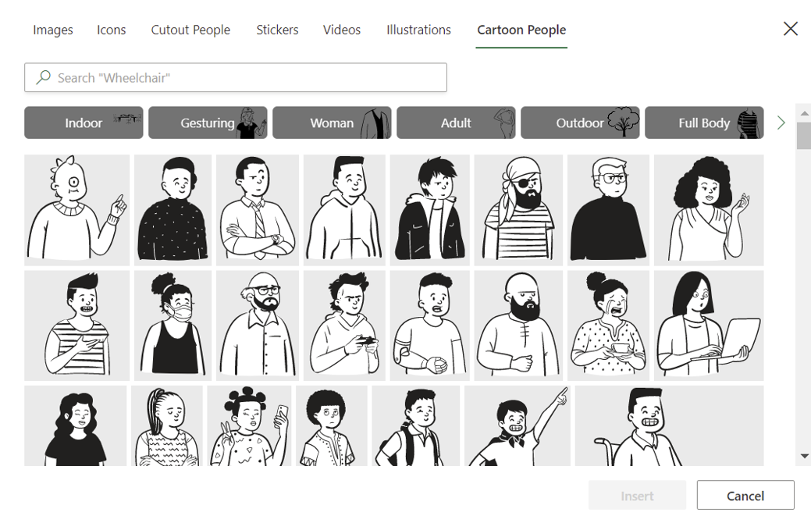


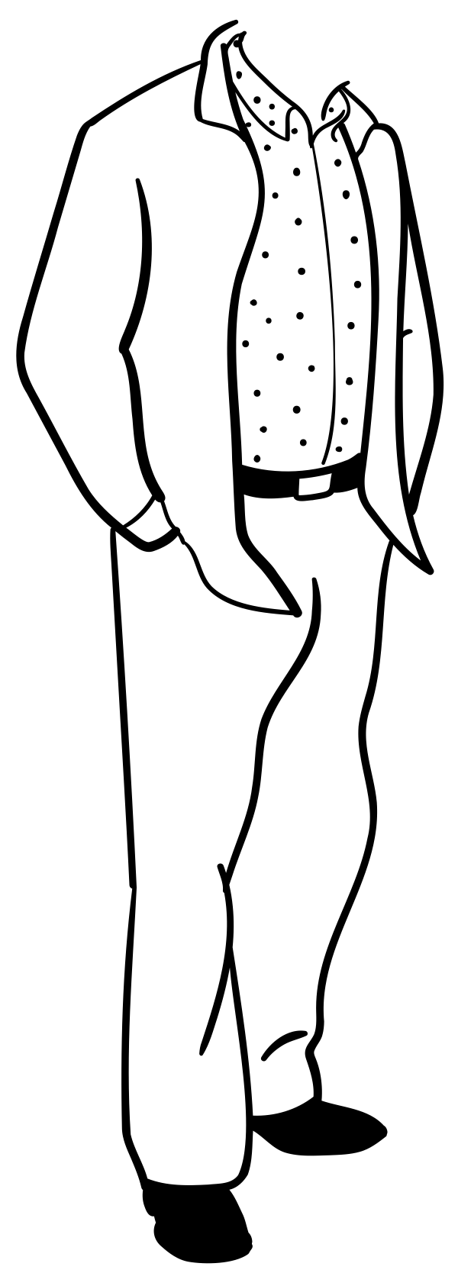

What are cartoon people?
Cartoon people illustrations are a fun way to create artwork and tell stories using a diverse set of characters and scenery.

Slide 3



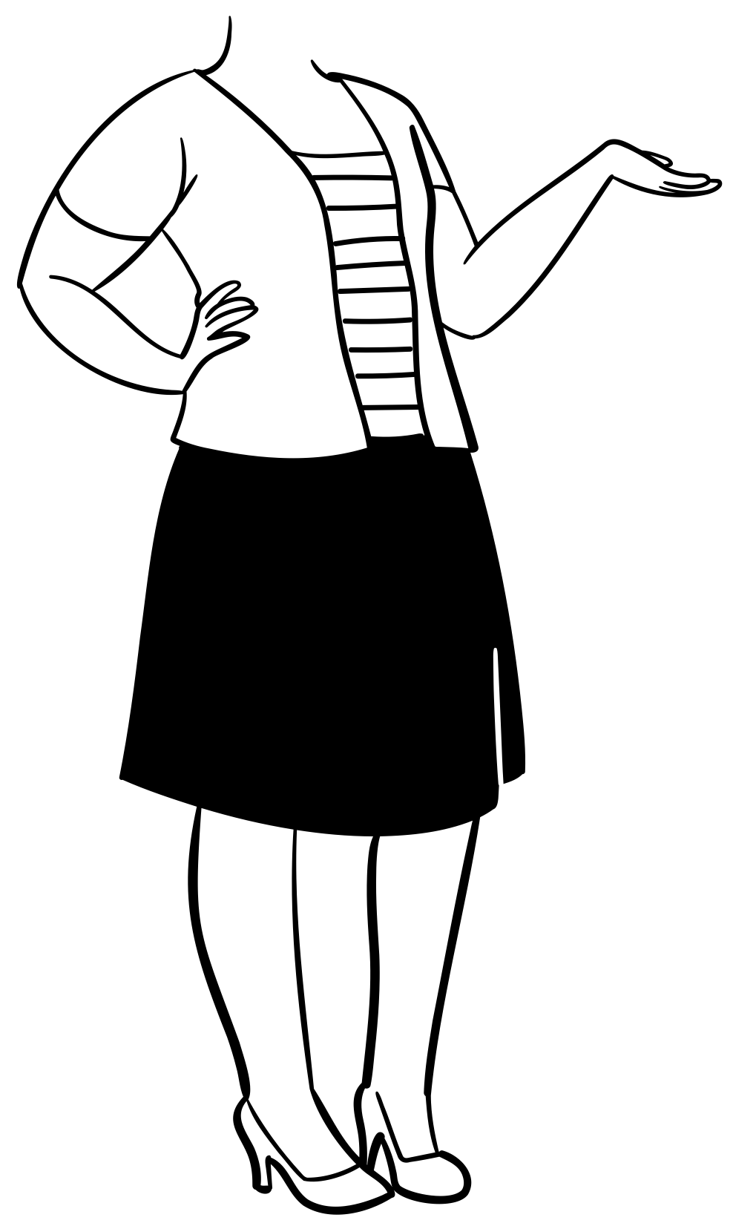

Try it out!
Let’s say you’re building a storyboard and want to add a cartoon woman to the scene.
1
Go to Insert > Picture > Stock images > Cartoon People to select the desired pieces to create your character, then choose Insert to place the illustration on your canvas.​
Mix & match different parts of the body, head, facial expressions, accessories, and decorations to assemble your person in the scene.
2
Body
Head & details
Custom assembled body

Slide 4

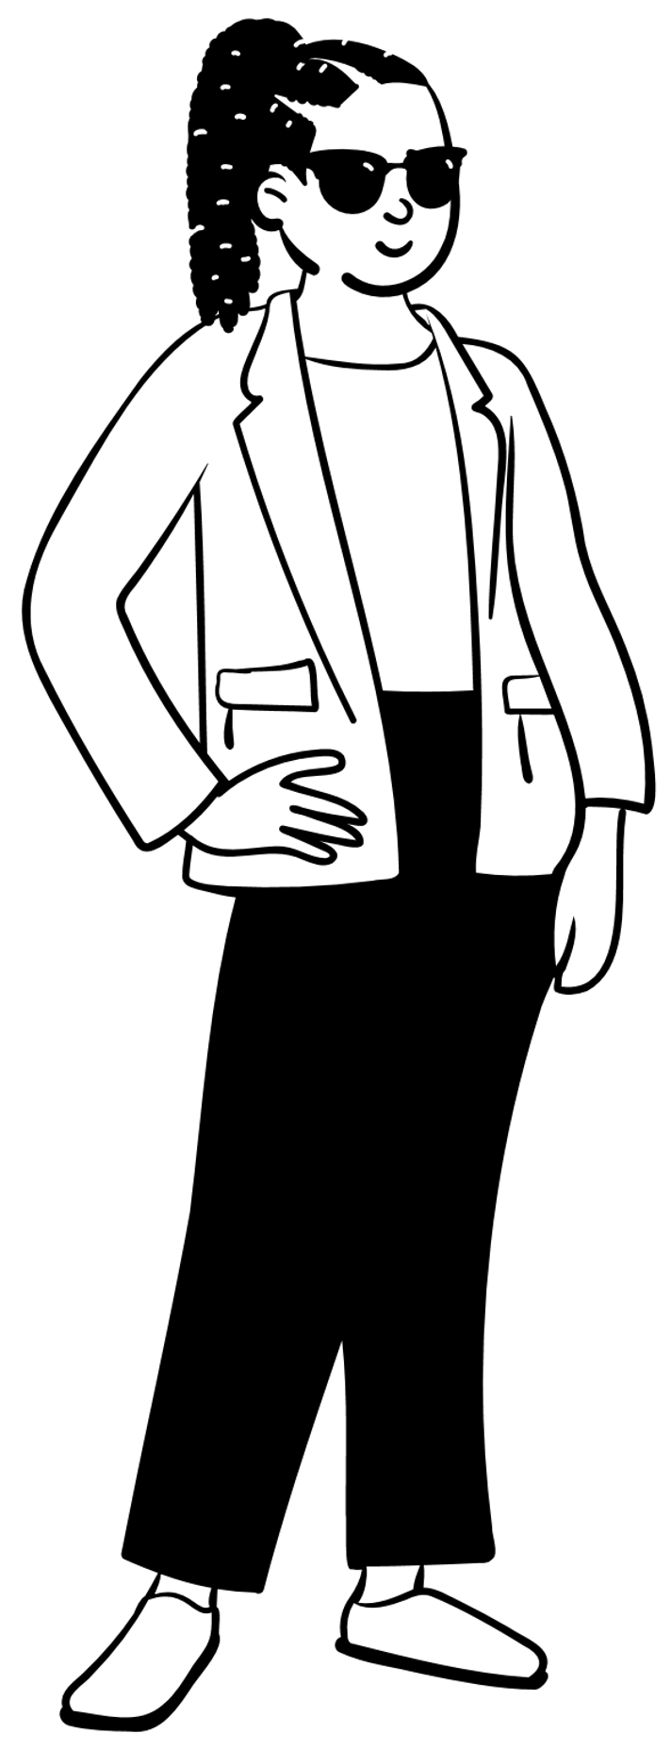

Save time with full characters
Don’t have time to assemble a character? Choose from a large set of preassembled characters, then ungroup into pieces to quickly customize your character later.
1
Go to Insert > Pictures > Stock images > Cartoon People to select a preassembled body, then select Insert to place the illustration on your canvas.​
Preassembled characters

Slide 5
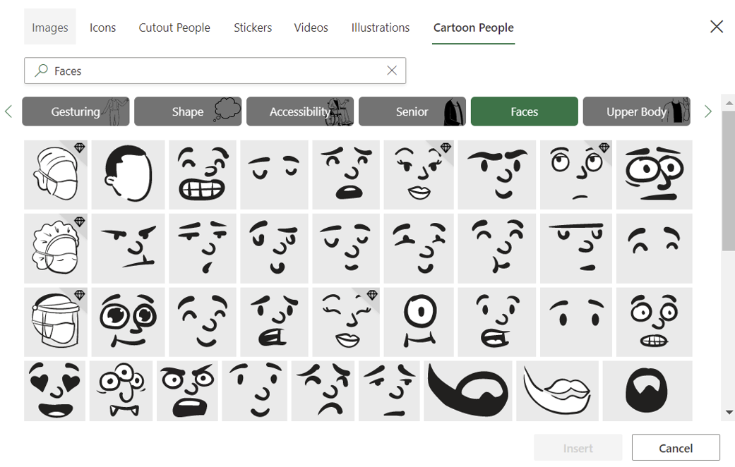
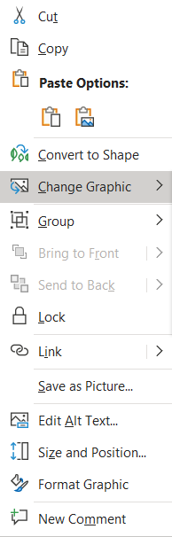
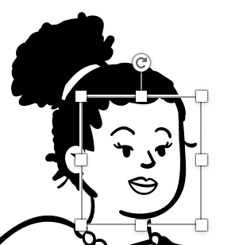
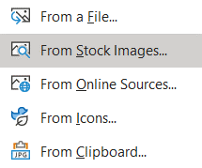
Modify details of any illustration
Cartoon people are customizable, allowing you to update features to fit your design. Try it out by adding a new expression to this person’s face.​
1
Right-click on the illustration and select Group > Ungroup.​
Right-click on the face and select Change Graphic > From Stock Images > Cartoon People and browse the Faces tab to select a new expression.​
Select a new expression and ​click Insert.
2
3

Slide 6


Add accessories to complete the scene
Create an immersive cartoon scene by adding different backgrounds to give your illustration a polished look. ​
Perfect!

Slide 7
Apply color for visual interest
Add color to any element of your illustration by ungrouping and selecting colors for each shape.
1
Right-click on the illustration and select Convert to Shape
Ungroup the illustration by right-clicking and selecting Ungroup.​
Select pieces of the illustration and click ​Shape Fill or Shape Outline to change colors. ​
Be creative and have fun!
2
Perfect!
2
2
3
4
Finished illustration

